Slide 1
LSM-Trees
Design Space & Read Optimizations
Based on IEEE ICDE 2023 (Conceptual Review Paper)
Authors : Subhadeep Sarkar | Niv Dayan | Manos Athanassoulis
Present by Raaj Patel

Slide 2
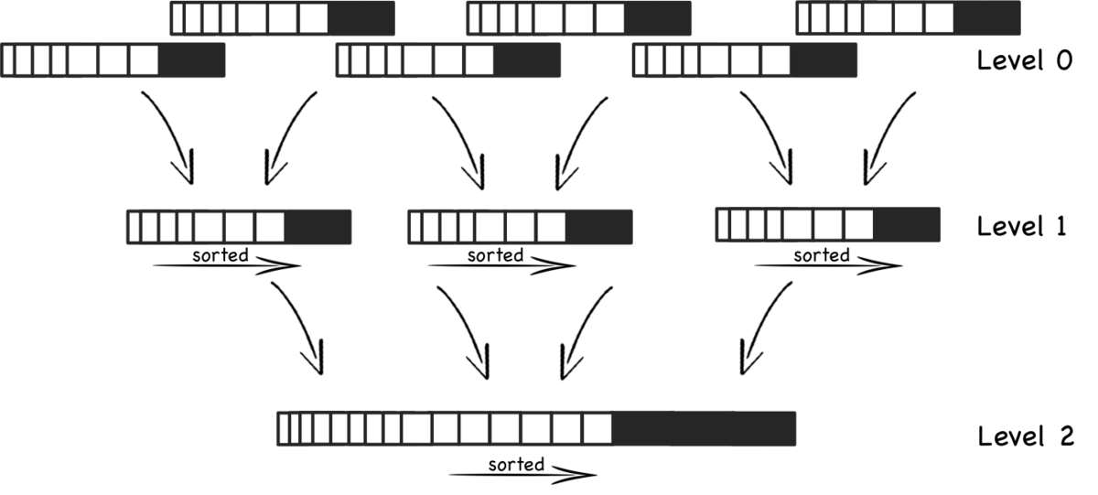
What is LSM ?
Log-structured merge (LSM) are a data structure in modern databases, particularly for applications requiring high write performance and efficient storage utilization.

Slide 3




Why do modern systems rely on LSM trees?
Modern systems process write-heavy workloads: time-series data, application logs, and continuous monitoring.
Random disk writes are slow
LSM trees batch writes into sequential, achieving 10–100× throughput gains in production systems.

Slide 4
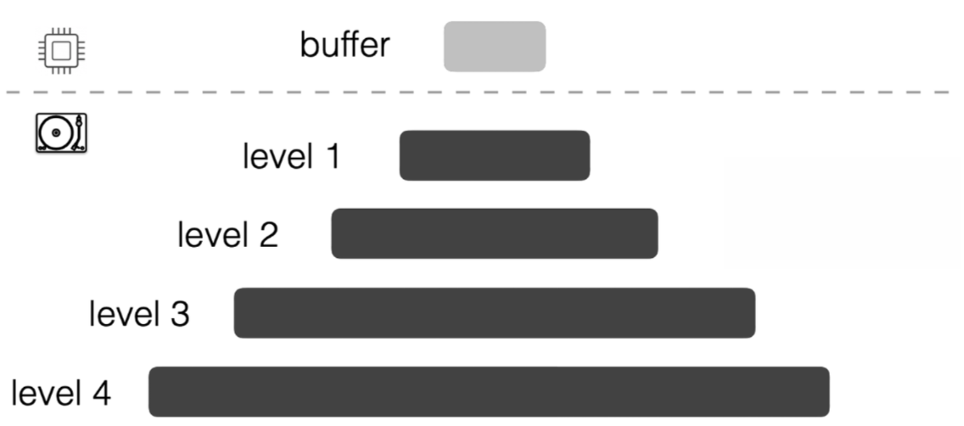
LSM Architecture Overview
Data is organized into hierarchical levels. Level-0 resides in memory as a memtable.
Levels 1 through N reside on disk, each storing multiple sorted runs (SSTables).
Compaction: sorting new data and merge with old data

Slide 5
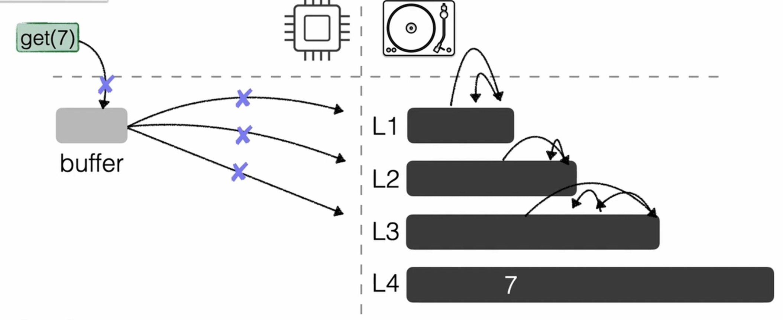
The Read Challenge
Write optimization comes at a cost: data is scattered across many files and levels. Each read may require checking multiple SSTables.
This is the fundamental LSM trade-off.
Read Path Cost
Multi-level lookup
Many files scanned for
just single key

Slide 6
Read Optimizations

Slide 7
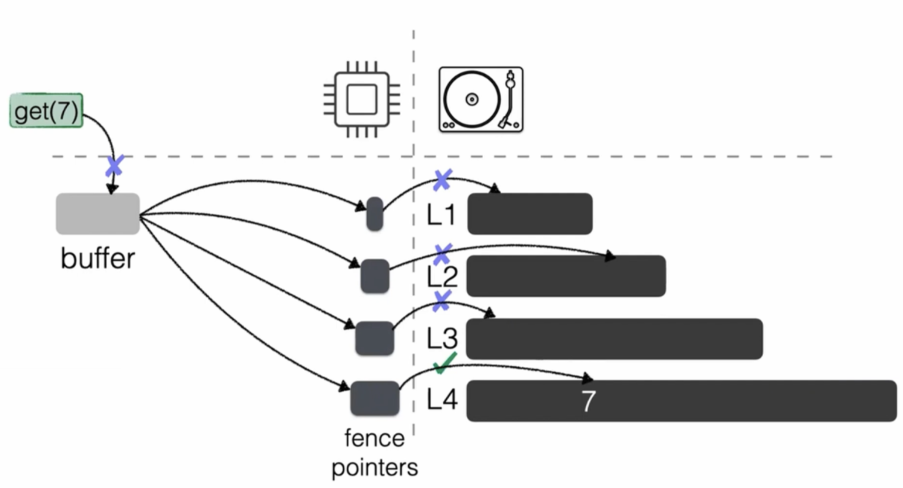
Read Optimizations
Fence pointers
Store boundary keys inside each SST file
Enable binary search inside large sorted files
Quickly skip irrelevant data blocks
Reduce disk I/O during point lookups

Slide 8
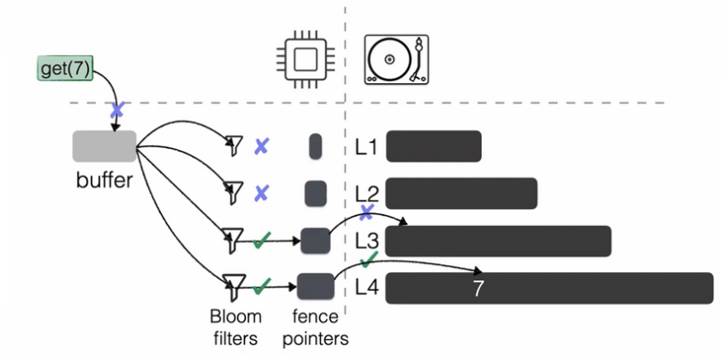
Read Optimizations
Bloom filters
Skip levels without key
Major speedup for single point lookups

Slide 9
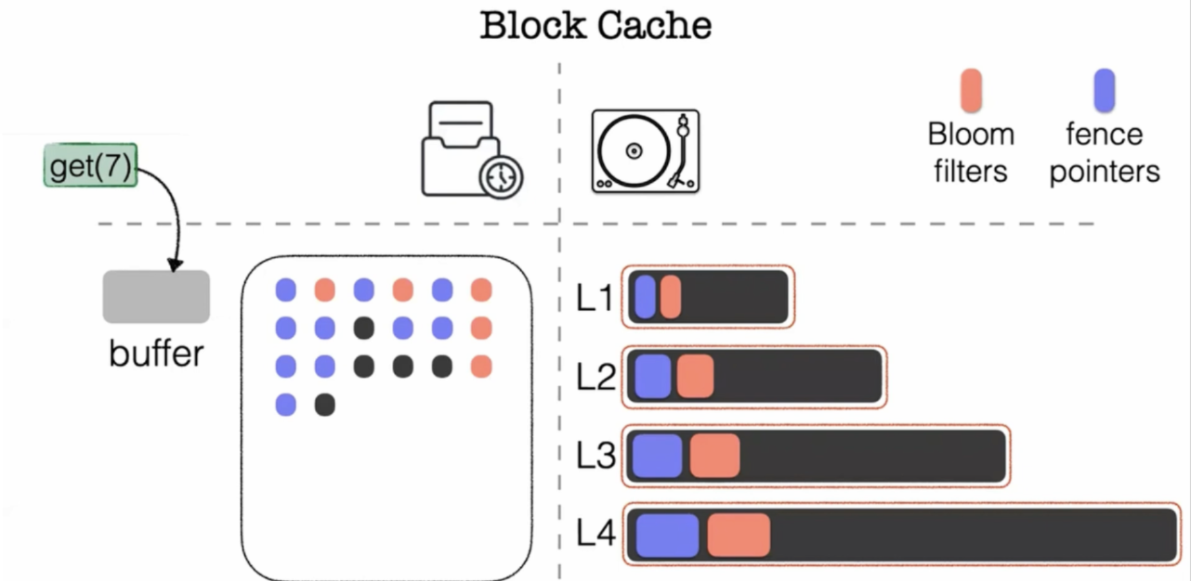
Read Optimizations
Block cache
Cache frequently accessed data blocks in memory
Avoid disk access for popular keys & ranges
Works with Bloom filters & fence pointers for faster reads

Slide 10
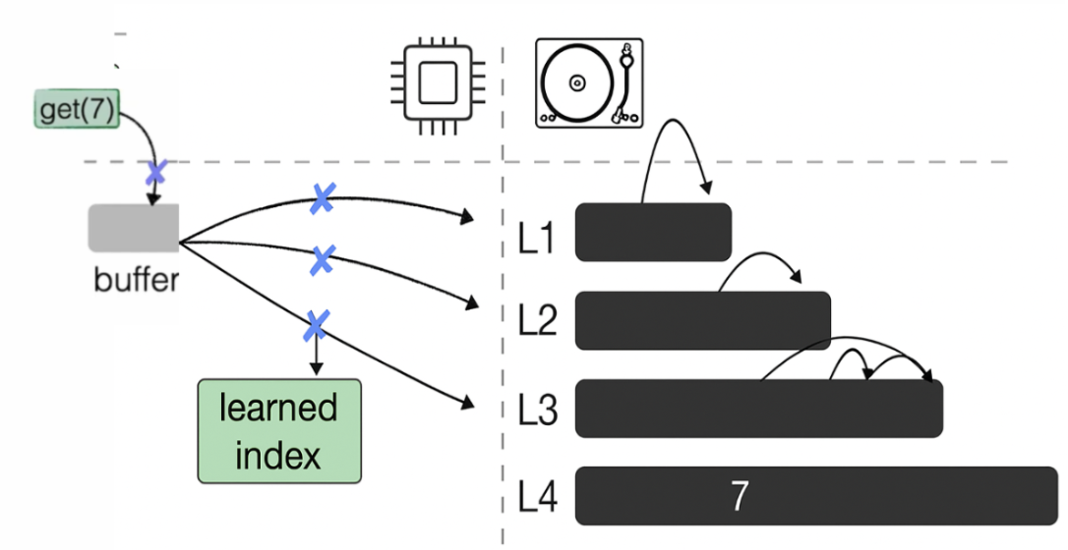
Read Optimizations
Learned Indexes
ML models predict key position in SSTs
Reduce binary search overhead
Lower memory use vs B-trees/fence pointers
Works great since SST files are immutable

Slide 11
Design Space Optimizations

Slide 12
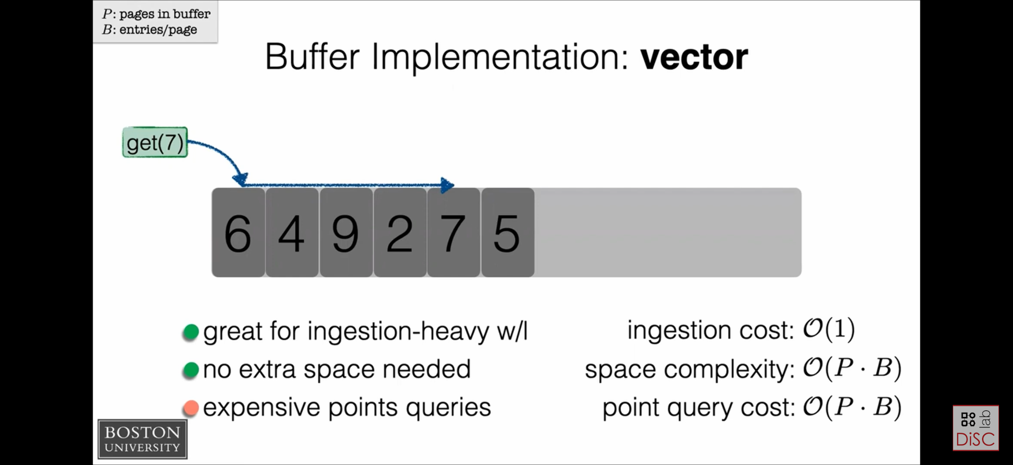
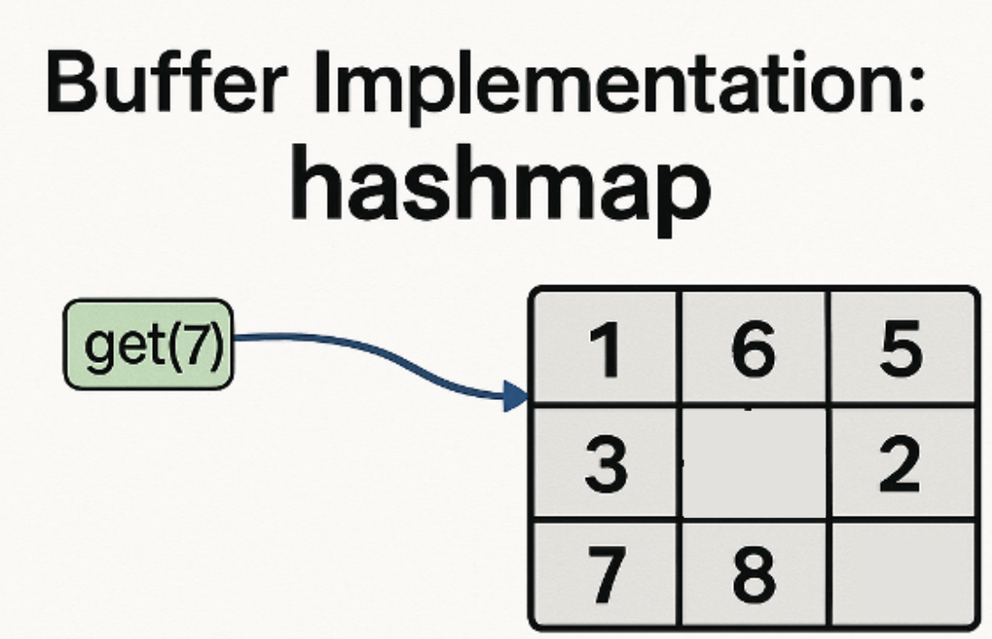
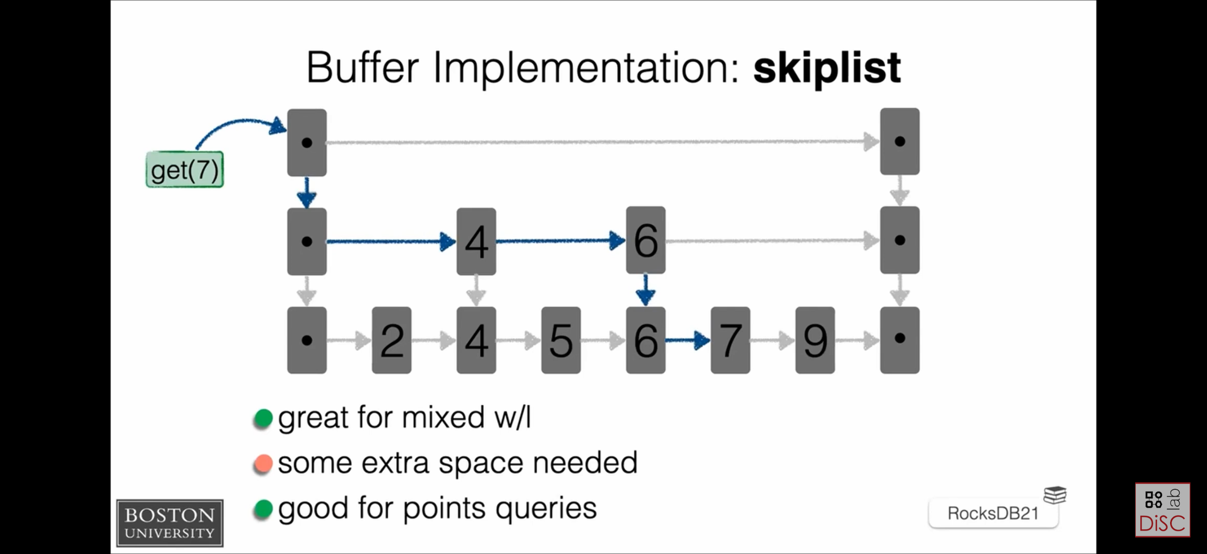
Design Space Optimization
Buffer
Buffer Design Choices
Different MemTable (buffer) structures impact lookup & insert performance
Choice depends on workload pattern (read-heavy vs write-heavy vs mixed)
Trade-off between lookup speed, memory usage, and ordering support

Slide 13
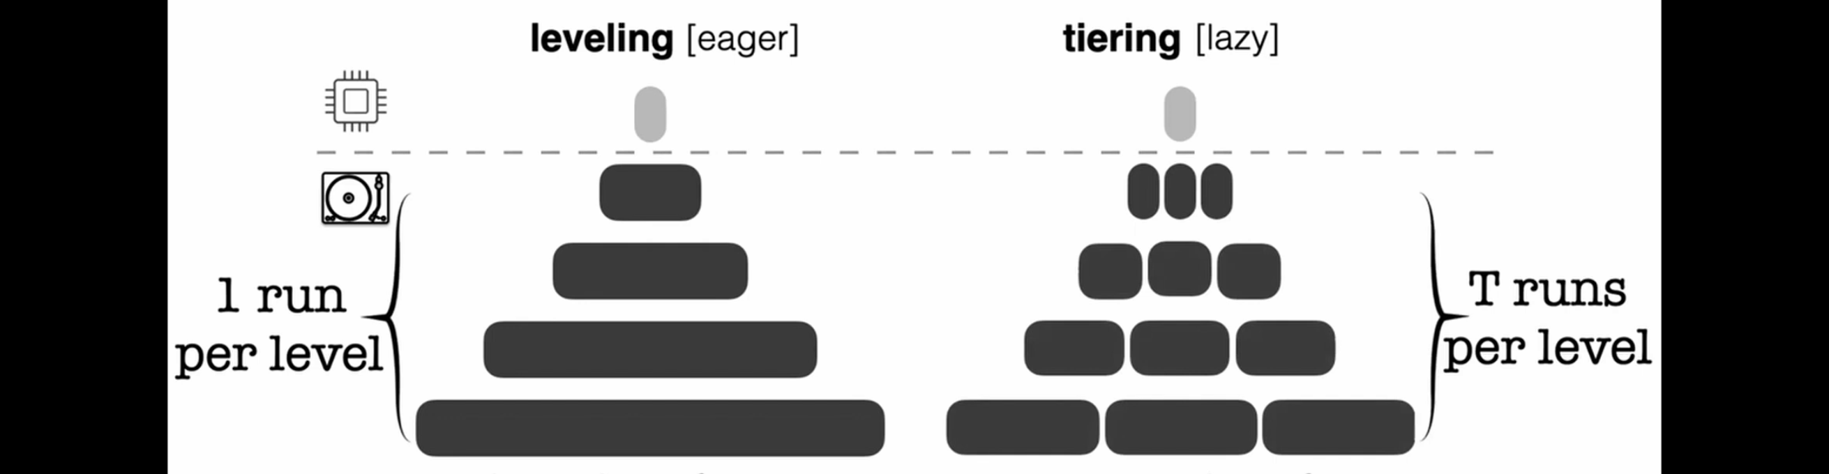
Design Space Optimization
Memory
Leveling for Read-optimized
Merges aggressively (1 run per level)
Better reads, but high write cost
Tiering for Write-optimized
Multiple runs per level, delayed merges
Fast ingest, but worse reads

Slide 14
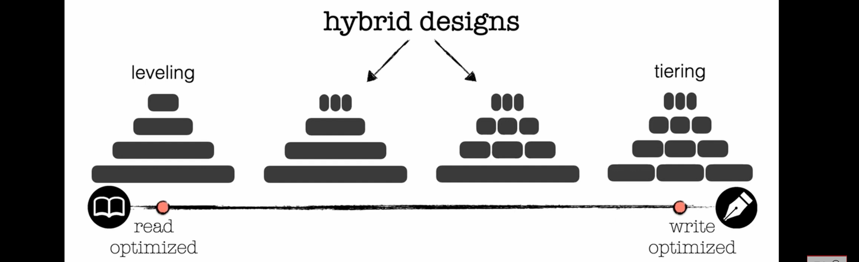
Design Space Optimization
Memory
Hybrid designs = Best of both
Tiering in upper levels for fast writes, leveling in lower levels for fast reads
Balanced performance

Slide 15
Modern LSM Tuning

Slide 16
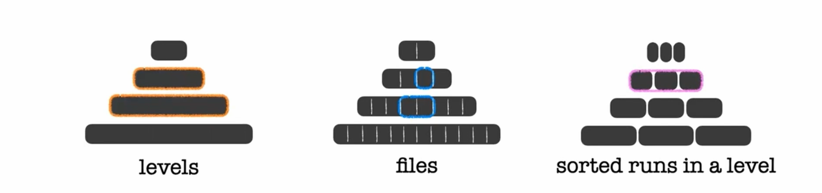
Modern LSM Tuning
Adaptive Compactions
Dynamically choose compaction granularity (levels / files / runs)
Adapt strategy based on workload pressure (read vs write)
Goal: minimize write stalls + reduce read amplification

Slide 17
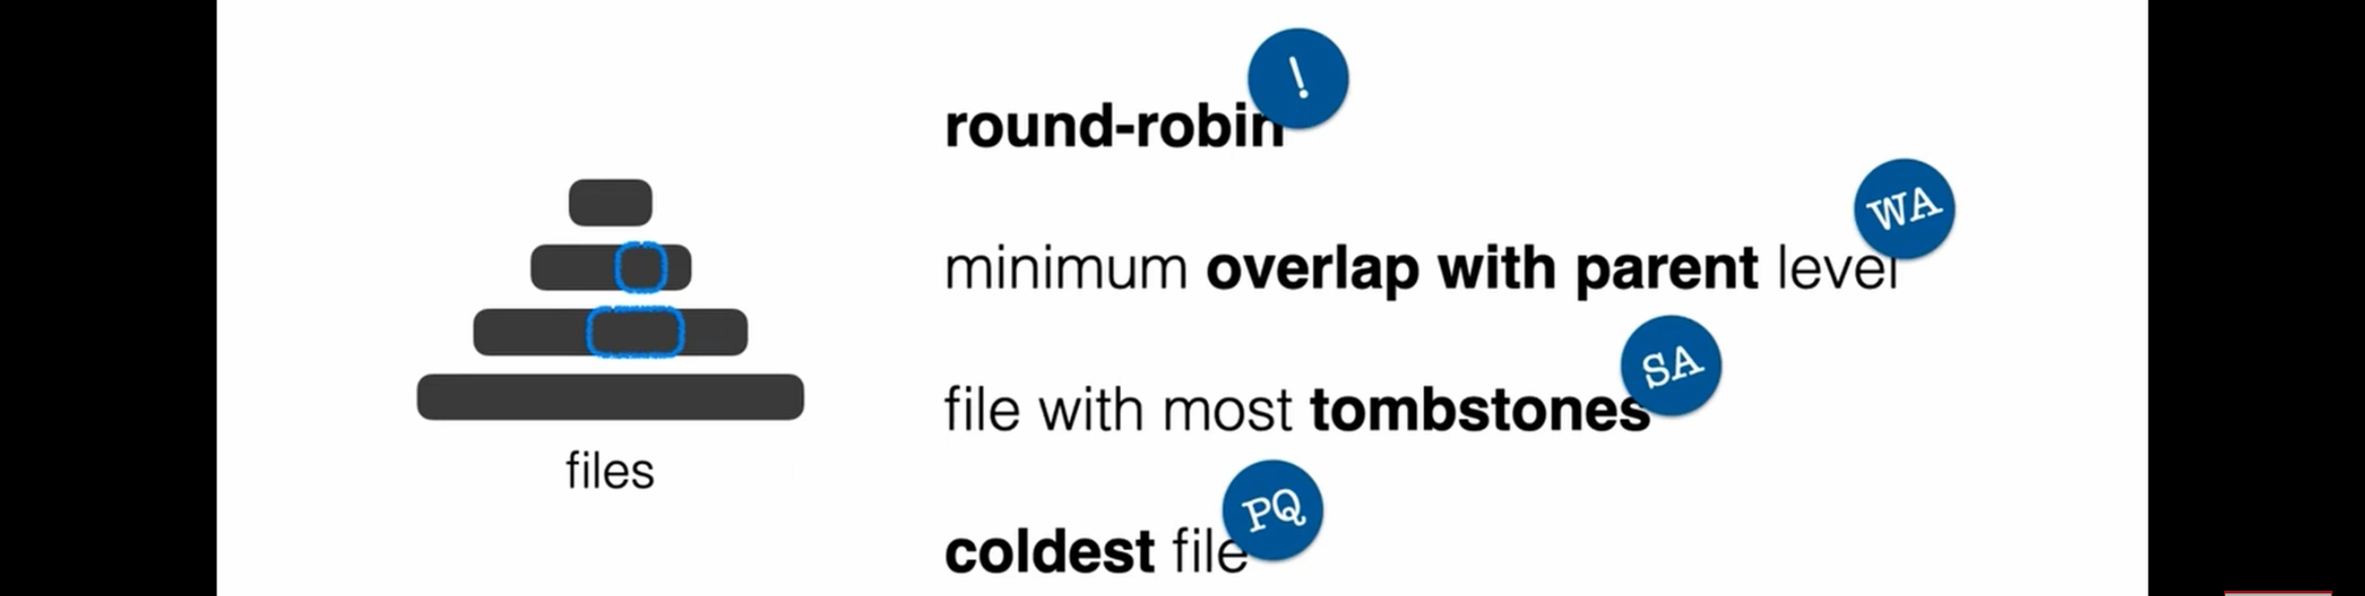
Modern LSM Tuning
Robust Tuning for Changing Workloads
Choose which files to compact first (smart scheduling)
Policies: round-robin, minimal overlap, tombstone-heavy, coldest files
Balances read cost, write cost, and space usage automatically

Slide 18
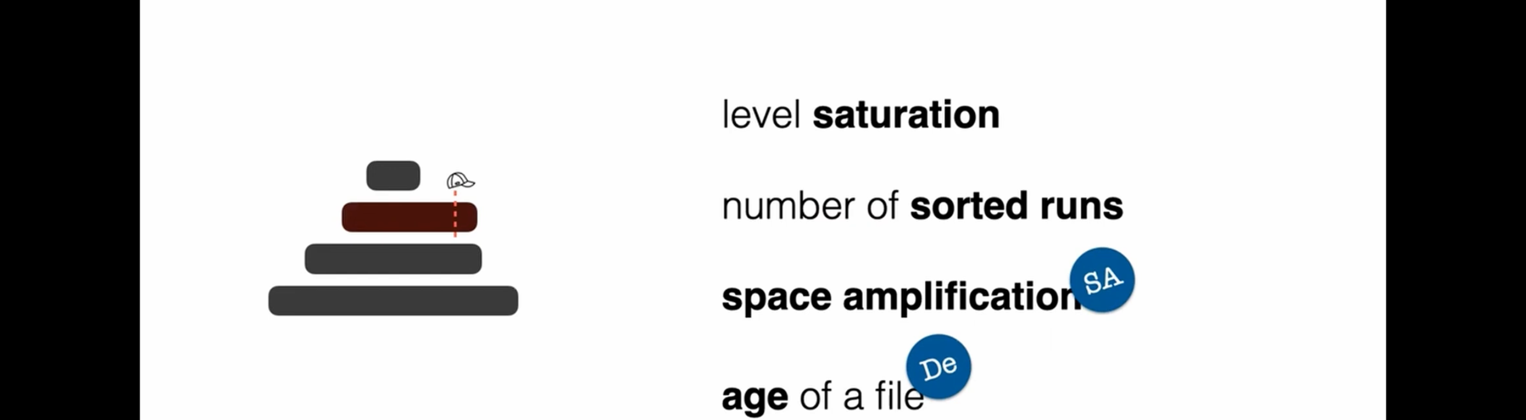
Modern LSM Tuning
Compaction Triggers & Auto-Learning
Trigger compaction based on level saturation, run count, space usage, or file age
Auto-learning adjusts thresholds over time
Systems evolve parameters automatically instead of manual tuning

Slide 19
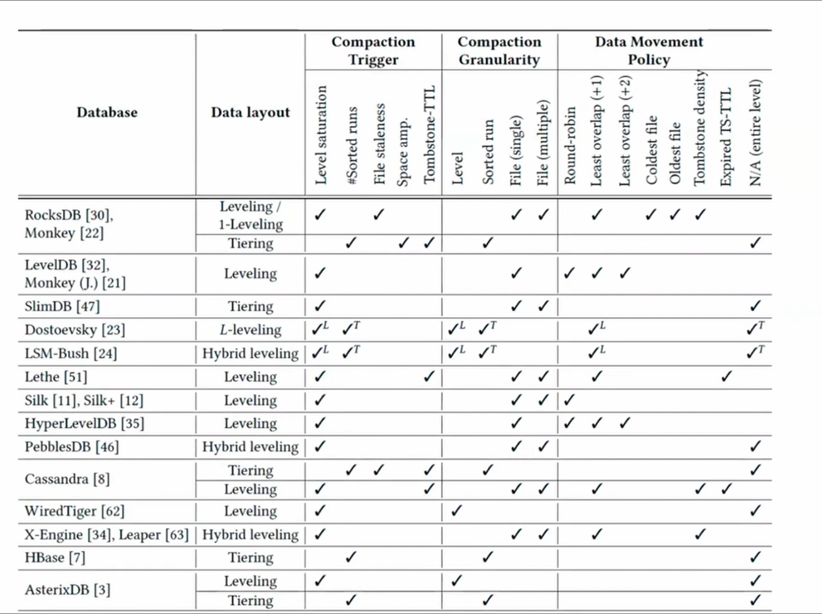
Comparisons Between Different Databases

Slide 20
Memory Tuning Problem

Slide 21
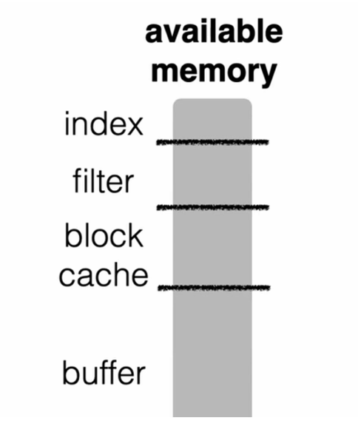

Memory Tuning Problem
Memory Tuning Challenge
Memory must be split between buffer, block cache, filters, and indexes
More memory to one component improves its performance but hurts others
Trade-off between update cost, read cost, and space footprint
Finding the optimal split is complex — still an open research problem

Slide 22
Conclusion
LSM for fast writes, smart read optimizations
Filters + indexes + caching are essential
Hybrid tuning yields best performance
Growing research + storage tuning

Slide 23
Thank You

Slide 24
Any Question ?

